Slide 1
Chapter 6
Electronic Structure of Atoms

Slide 2

1. The wavelength of light emitted from a traffic light having a frequency of 5.75 × 10¹⁴ Hz is __________.
A) 702 nm
B) 641 nm
C) 674 nm
D) 522 nm
E) 583 nm
D

Slide 3
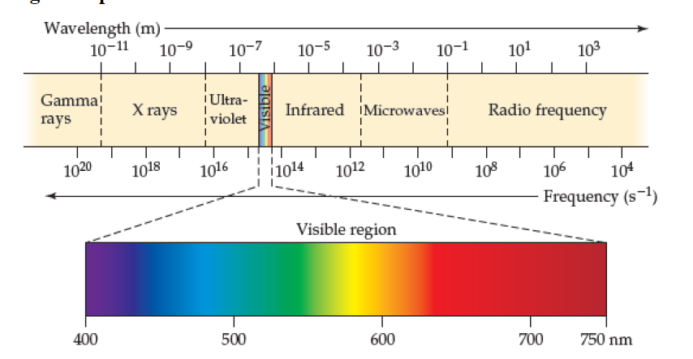
2. Of the following, __________ radiation has the shortest wavelength.
A) X-ray
B) radio
C) microwave
D) ultraviolet
E) infrared
A

Slide 4
3. The photoelectric effect is __________.
A) the total reflection of light by metals giving them their typical luster
B) the production of current by silicon solar cells when exposed to sunlight
C) the ejection of electrons by a metal when struck with light of sufficient energy
D) the darkening of photographic film when exposed to an electric field
E) a relativistic effect
C

Slide 5
4. Of the following transitions in the Bohr hydrogen atom, the __________ transition results in the emission of the highest-energy photon.
A) n = 1 → n = 6
B) n = 6 → n = 1
C) n = 6 → n = 3
D) n = 3 → n = 6
E) n = 1 → n = 4
B

Slide 6

5. According to the Heisenberg Uncertainty Principle, it is impossible to know precisely both the position and the __________ of an electron.
A) mass
B) color
C) momentum
D) shape
E) charge
C

Slide 7
6. All of the orbitals in a given subshell have the same value of the __________ quantum number.
A) principal
B) angular momentum
C) magnetic
D) A and B
E) B and C
D

Slide 8
7. Which of the subshells below do not exist due to the constraints upon the angular momentum quantum number __________?
A) 2d
B) 2s
C) 2p
D) all of the above
E) none of the above
A

Slide 9
8. An electron cannot have the quantum numbers n = __________, l = __________, m_{l} = __________.
A) 6, 1, 0
B) 3, 2, 3
C) 3, 2, -2
D) 1, 0, 0
E) 3, 2, 1
B

Slide 10
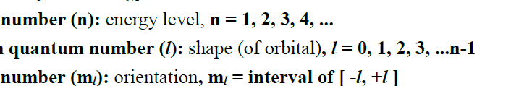
9. Which quantum number determines the energy of an electron in a hydrogen atom __________?
A) n
B) E
C) m_{l}
D) l
E) n and l
A

Slide 11
10. In a p_{x} orbital, the subscript x denotes the __________ of the electron.
A) energy
B) spin of the electrons
C) probability of the shell
D) size of the orbital
E) axis along which the orbital is aligned
E

Slide 12
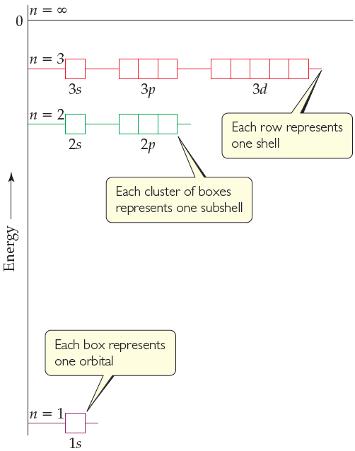
11. At maximum, an f-subshell can hold __________ electrons, a d-subshell can hold __________ electrons, and a p-subshell can hold __________ electrons.
A) 14, 10, 6
B) 2, 8, 18
C) 14, 8, 2
D) 2, 12, 21
E) 2, 6, 10
A

Slide 13
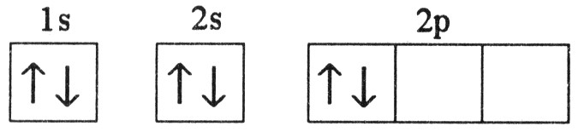
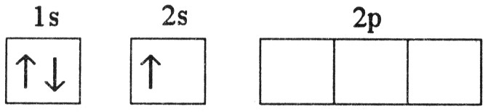
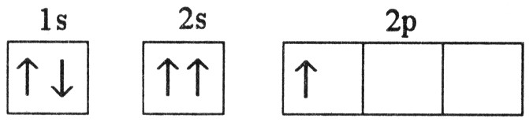
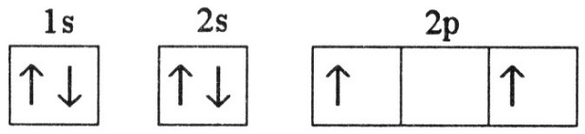
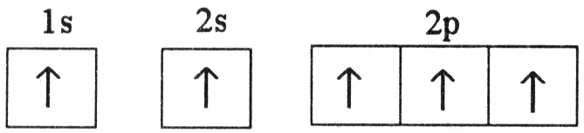
12. Which electron configuration represents a violation of the Pauli exclusion principle __________?
A)
B)
C)
D)
E)
C

Slide 14
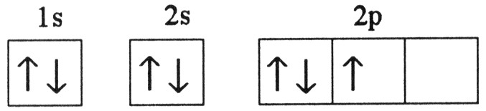
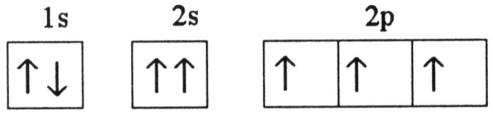
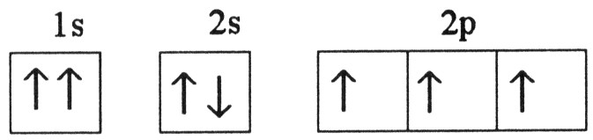
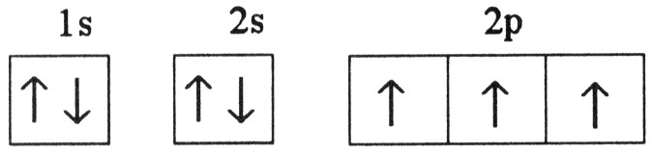
13. Which one of the following is the correct electron configuration for a ground-state nitrogen atom __________?
A)
B)
C)
D)
E) None of the above is correct.
D

